Slide 1
Commentary:
1. DA’s patient/family replacement Revolution vs. MCO Inc. Goliath
“…solution is holding people accountable for being prudent consumers of health care…”
2. System retail market Revolution/Evolution absent Goliath
MPPA Meeting
June 2, 2026

Slide 2
Medical System Dystopia: Dx and Rx
(good corporate and professional people are trapped in a politicaly created malignant system)
Dx: cost inflation obsession since 1970 (quality and access suffer)
Price-free Pre-paid cartel care ←US corporate and NHS cartels ration access
High priced baronial cartel “coverage” ←premiums and/or taxes.
→ ironic patient/family, hospital (ACO), and national poverty + system $ Zillions + PE vultures readied to suck up the juice. Hmmmm…...
Rx:
Eliminate “payer” corporations
Empower families with money, not corporations
Battle:
David and everybody vs. Goliath
Don’t bring a slingshot to this knife fight, bring a gun! [David’s caliber is large]
1st a Medical CPI inflation refresher

Slide 3
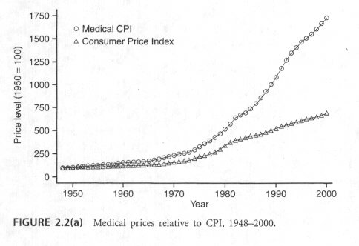
Medical CPI inflation refresher: 1875-1989 timeline
From 0% to 18% in 1988 → Inflation Poverty “for all”
Double digit inflation
(18%) of premium rates)
1942 Employee Ins. Subsidies:
“employer-based system”
1965 Medicare,
Medicaid
7 %“crisis”
6.3 fold increase
1875-1965**
Chart modified from Phelps CE. Health Economics. Addison Wesley. 2003:48.
Ibid 7% crisis; 515.
**Anderson OW. Health Care: Can There Be Equity? 1972

Slide 4
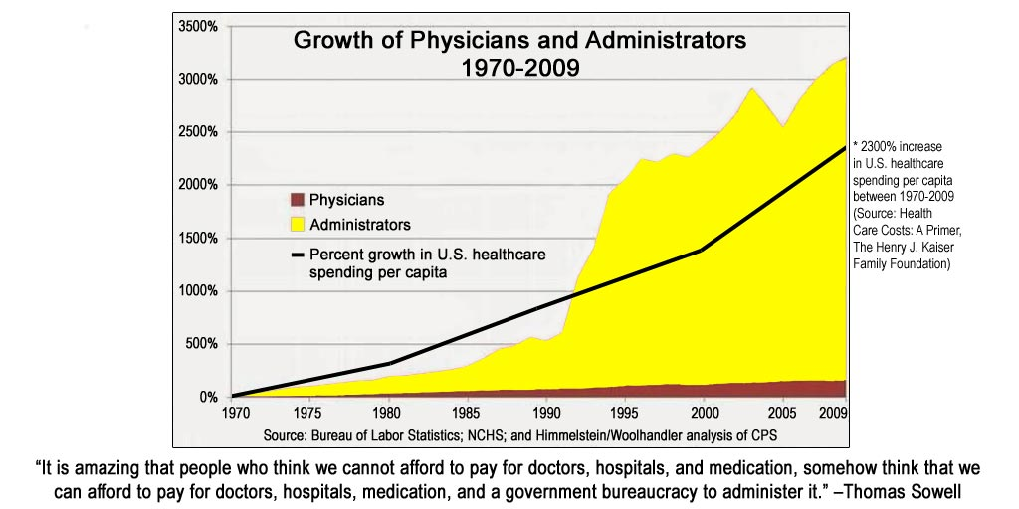
Systemic inflation→ Managed (CPOM) Poverty for all
(ala the Soviet Union ”managed ”economy )
Medical poverty? ← “Managed care”, i.e., fed-corporate-cartels → How do cartels work: fix prices and endorse who or what produces services and pre-paid “coverage” and ration access to care for “cost control” (not insurance)
→1973 HMO Act akin to
  NHS cost control cartel
  rationing abroad
  → high-cost “baronial”
  wizards → internal inflation problem
1988-18% premium inflation
1994-HMO nirvana time

Slide 5
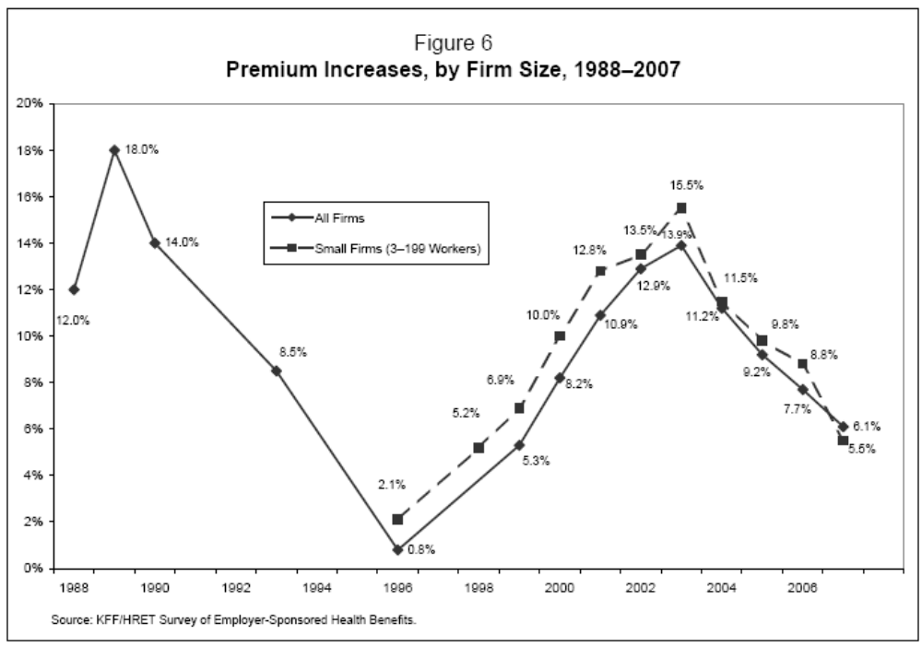

HMO Effect: Inflation from 18% to 1-2%....then oops
Premium trends
HSA-HDHP Era
2004-2009
MN 2007 small market
(4 large Plan survey)
MCO: + 3.36%
HDHP: – 5.14%

Slide 6
A Systemic Problem: social engineered (SE) Poverty
What casaues inflation? [Social Engineered (SE) apparent “free” stuff leads to demand inflation]
What causes poverty?
  [SE high-priced corporate “coverage” to ration “free” stuff]
  [SE cost of rationing of free stuff]]
What causes prosperity? Absence of social engineered centralized private sector cartel collusion and coercion, (i.e., retail medical marketplace concept simiilar to all others popularized by Profs Charles Silver and David Hyman 2018-2026)
Is David Allen’s proposal a path to No-inflation, Quality, and Access?
  Admirable goals? Yes
    Empowered patients,
    Elimination of corporate cartel care (i.e., CPOM profiteering masquerading as “value pay”
  A concern: Is the “revolution” only social engineering from MCO barons to Fed barons?
  [Noel Collis: Is this, "A government backed credit card- what could go wrong?“]

Slide 7
(1) Allen’s Revolutionary Results: a retail market milieu vs. regime approved beliefs in MCO inc.
Gone: Costly massive bureaucracies→
Gone: Profiteering from rationing care.
Restored: Patient is the “single-payer” similar to every other retail sector where we buy shoes, shirts, car, houses and rheir insuance, (the 2004-2009 HSA-HDHP era retail medial marketplace)
Is a retail-like medical marketplace “happiness”
or “frightening”? Frightening to corporate docs, the public, and health gurus, who can’t imagine a system without one-stop prepaid (“price-free”) corporate palaces?

Slide 8
(2) Allen’s Revolutionary Results: Follow the money….
“…requires little government bureaucracy,
  “…some regulation remains essential.
  “…protecting from price gouging is important especially for emergencies and where competitive optios are limited.
    [Q: “Prohibit gouging”. Is this price fixing?]
“…providers must be required to charge prices consistent with those charged in competitive markets.”
? Problems with David’s big caliber gun? Price fixing? Are feds only a new 3rd party panacea of regulatory Hi/Lo income complexity? → self adjusted or endless IRS regs and hassles? Total program cost? ($8.85T vs $5.28T spent in 2024)
Are there other ways of Eliminating medicine’s CPOM dystopias without creating a new Fed replacement program? Yes

Slide 9
11/11/25 Focus on Eliminating the CPOM→ a retail med market:
Five compatible alternatives (different caliber guns!)
1. John Diehl JD: amend the federal ERISA law to prohibit the corporate practice of medicine in ERISA health plans, and to allow the states to adopt complementary regulations on a state-by-state basis.”
2. Dave Feinwachs, JD, PhD{ This fraud could be stopped with the stroke of a pen, if President Trump repeals Minnesota's 1115 waivers. Cutting off the massively inflated Medicaid funding would kill some of theseCPOM entities and winnow down others through natural selection
3 Bod Koshnick MD: abolish CON and PC for all
4. Sen. Gruenhagen: Create a MN Medicaid retail OP marketplace, using a debit card. SF 1261. [HMOs don’t qualify.] Exclusive Medicaid HSA-like debit card accounts for use in an OP retail market; catastrophic expenses paid by Medicaid TPA. Medicaid fee rates increased to Medicare rates (~25% increase)
5.Steve Parente PhD: Health Savings Empowerment Plan; a Market Based Alternative to Medicare For All.
Goal: Restore a retail medical marketplace. [Profs. Charles Silver and David Hyman 2018-2026] Would a retail market eliminate complexity and profiteering scams when cartel care (CPOM) is gone? Why not.
What would be System and Clinician response?

Slide 10
Predictable: System Evolution without MCO inc. in a Retail Medical Marketplace
Presumes Inflation controlled:
  Gone: costly pre-paid “coverage”
  Gone: MCO/ACO profiteering from rationing care
System response akin to 2004-2009 era
  Indemnity insurance, e.g., in 2004-2009 era HSA-HDHPs even if fed subsidies remain [I think they will].
  Families/patients Kings in the medical marketplace (personal medical budgets)
    → “single payer” consumer akin to all other micro-econ sectors where we buy and may insure refrigerators, homes, cars, etc.
Affordable public programs predictable if MN Medicaid reform (SF 1261) becomes a paradigm for Medicare. Presumes CPOM is shot down by our MN Medicaid Reform big gun.

Slide 11
Predictable: Clinician Evolution in a Retail Medical Marketplace
Cliniician response: Person-centered care structure evolution
  Local ACO clinic Palaces →professional buildings
    Large FFS clinics ← ACO Hospital staff (mini PN or Mayo clinics)
    Small FFS clinics ← ACO hospital staff
  Mixed or solo specialty clinics
  Specialty surgeons, internists, FP, Derm, OB/Gyn, etc.
  Direct Pay Clinics—monthly or annual fees
  Concierge clinics

Slide 12
Is there a System Fix for Patients, Hospitals, and Nations Driven into Poverty?
Is it Liberty? Yes!
What causes systemic poverty?.State private sector social engineering managed → “free” stuff → cost
  The story of Soviet centralized power and collective ideology.
  Hostility to individual liberty and economic freedom
What causes systemic prosperity? A retail marketplace.^{[1]} (T. Jefferson of VA, Declaration of Independence)
  A person’s “inalienable”(natural) rights to “life, liberty, and pursuit of happiness”…., i.e., prosperity
  Grounded in individual de-centralized power and protected by the Constitution,
The magic sauce of liberty? It’s [Edmund Burke’s] “little platoons of free discussion groups to perpetuate liberty
  —that’s individuals like David Allen and us vs Goliath;
  ---that’s our US Constitution protecting our individual liberty to speak, think, and to act.
Action is necessary and it is up to each of you to apply your abilities to achieve a new medical Evolution!
  A place without cartel “care”
  Remember: The system is malignant not corporate barons or docs. They are innocent but stuck in the system!
  Don’t bring a slingshot to this knife fight, bring a gun!
Thanks David
1. Silver C, Hyman DA. Overcharged: why Americans pay too much for health care. Cato institute, 2018:331-335.

Slide 13
Reviewed:
1. Davd Allen’s patient/family replacement Revolution vs. MCO Inc. Goliath
“…solution is holding people accountable for being prudent consumers of health care…”
2. System retail Revolution/Evolution absent the MCOs
MPPA Meeting
June 2, 2026

